Slide 1
Implementation of Stack

Slide 2

Implementation of Stack
A stack is an Abstract Data Type (ADT), commonly used in most programming languages. It is named stack as it behaves like a real-world stack, for example – a deck of cards or a pile of plates, etc.
Stack Example

Slide 3
Stack Data Structure
Stack is a linear data structure which follows a particular order in which the operations are performed. The order may be LIFO(Last In First Out) or FILO(First In Last Out).
Mainly the following three basic operations are performed in the stack:
Push: Adds an item in the stack. If the stack is full, then it is said to be an Overflow condition.
Pop: Removes an item from the stack. The items are popped in the reversed order in which they are pushed. If the stack is empty, then it is said to be an Underflow condition.
Peek or Top: Returns top element of stack.
isEmpty: Returns true if stack is empty, else false.

Slide 4
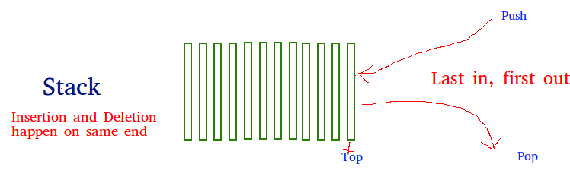
How to understand a stack practically?
There are many real life examples of stack. Consider the simple example of plates stacked over one another in canteen. The plate which is at the top is the first one to be removed, i.e. the plate which has been placed at the bottommost position remains in the stack for the longest period of time. So, it can be simply seen to follow LIFO/FILO order.

Slide 5
Applications of stack:
Balancing of symbols
Infix to Postfix /Prefix conversion
Redo-undo features at many places like editors, photoshop.
Forward and backward feature in web browsers
Used in many algorithms like Tower of Hanoi, tree traversals, stock span problem, histogram problem.
Other applications can be Backtracking, Knight tour problem, rat in a maze, N queen problem and sudoku solver
In Graph Algorithms like Topological Sorting and Strongly Connected Components

Slide 6
Time Complexities of operations on stack:
push(), pop(), isEmpty() and peek() all take O(1) time. We do not run any loop in any of these operations.
Implementation: There are two ways to implement a stack:
Using array
Using linked list

Slide 7
A real-world stack allows operations at one end only. For example, we can place or remove a card or plate from the top of the stack only. Likewise, Stack ADT allows all data operations at one end only. At any given time, we can only access the top element of a stack.
This feature makes it LIFO data structure. LIFO stands for Last-in-first-out. Here, the element which is placed (inserted or added) last, is accessed first. In stack terminology, insertion operation is called PUSH operation and removal operation is called POPoperation.

Slide 8
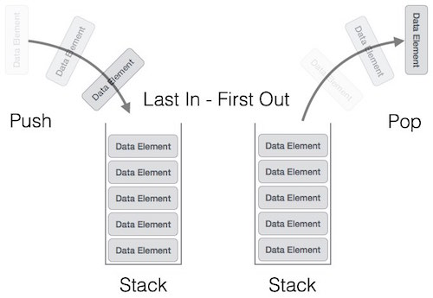
A stack can be implemented by means of Array, Structure, Pointer, and Linked List. Stack can either be a fixed size one or it may have a sense of dynamic resizing. Here, we are going to implement stack using arrays, which makes it a fixed size stack implementation.

Slide 9
Basic Operations
Stack operations may involve initializing the stack, using it and then de-initializing it. Apart from these basic stuffs, a stack is used for the following two primary operations −
push() − Pushing (storing) an element on the stack.
pop() − Removing (accessing) an element from the stack.
When data is PUSHed onto stack.

Slide 10
To use a stack efficiently, we need to check the status of stack as well. For the same purpose, the following functionality is added to stacks −
peek() − get the top data element of the stack, without removing it.
isFull() − check if stack is full.
isEmpty() − check if stack is empty.
At all times, we maintain a pointer to the last PUSHed data on the stack. As this pointer always represents the top of the stack, hence named top. The top pointer provides top value of the stack without actually removing it.
First we should learn about procedures to support stack functions −

Slide 11
Peek()
peek()
Algorithm of peek() function −
begin procedure peek
return stack[top]
end procedure
Implementation of peek() function in C programming language −
Example
int peek() {
return stack[top];
}

Slide 12
Algorithm of isfull() function
begin procedure isfull
if top equals to MAXSIZE
return true
else
return false
endif
end procedure
Implementation of isfull() function in C programming language .

Slide 13
Example
bool isfull() {
if(top == MAXSIZE)
return true;
else
return false;
}

Slide 14
Algorithm of isempty() function −
begin procedure isempty
if top less than 1
return true
else
return false
endif
end procedure
Implementation of isempty() function in C programming language is slightly different. We initialize top at -1, as the index in array starts from 0. So we check if the top is below zero or -1 to determine if the stack is empty. Here's the code −

Slide 15
Example
bool isempty() {
if(top == -1)
return true;
else
return false;
}
Example
bool isfull() {
if(top == MAXSIZE)
return true;
else
return false;
}

Slide 16
Push Operation
The process of putting a new data element onto stack is known as a Push Operation. Push operation involves a series of steps −
Step 1 − Checks if the stack is full.
Step 2 − If the stack is full, produces an error and exit.
Step 3 − If the stack is not full, increments top to point next empty space.
Step 4 − Adds data element to the stack location, where top is pointing.
Step 5 − Returns success.

Slide 17
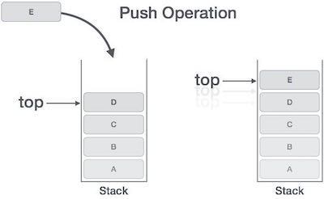
PUSH OPERATIONS
If the linked list is used to implement the stack, then in step 3, we need to allocate space dynamically.

Slide 18
Algorithm for PUSH Operation
A simple algorithm for Push operation can be derived as follows −
begin procedure push: stack, data
if stack is full
return null
endif
top ← top + 1
stack[top] ← data
end procedure

Slide 19
Pop Operation
Accessing the content while removing it from the stack, is known as a Pop Operation. In an array implementation of pop() operation, the data element is not actually removed, instead topis decremented to a lower position in the stack to point to the next value. But in linked-list implementation, pop() actually removes data element and deallocates memory space.
A Pop operation may involve the following steps −
Step 1 − Checks if the stack is empty.
Step 2 − If the stack is empty, produces an error and exit.
Step 3 − If the stack is not empty, accesses the data element at which top is pointing.
Step 4 − Decreases the value of top by 1.
Step 5 − Returns success.

Slide 20
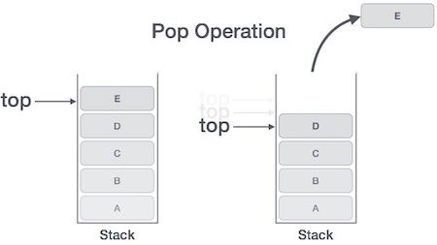
Pop operation

Slide 21
Algorithm for Pop Operation
A simple algorithm for Pop operation can be derived as follows −
begin procedure pop: stack
if stack is empty
return null
endif
data ← stack[top]
top ← top - 1
return data
end procedure
Implementation of this algorithm in C, is as follows −

Slide 22
Implementation of this algorithm in C, is as follows − Example
int pop(int data) {
if(!isempty()) {
data = stack[top];
top = top - 1;
return data;
} else {
printf("Could not retrieve data, Stack is empty.\n");
}
}

Slide 23
THANK YOU

